Slide 1

COMP 141
CS1: Programming Fundamentals
Notes:
Do ice-breaker;
Have students introduce themselves, tell their year in school and favorite food.

Slide 2
Introductions
Who am I?
Who are you?
Year, major, hometown, one positive word people use to describe you and an interesting fact about yourself.
What do you hope to learn in this class?

Slide 3


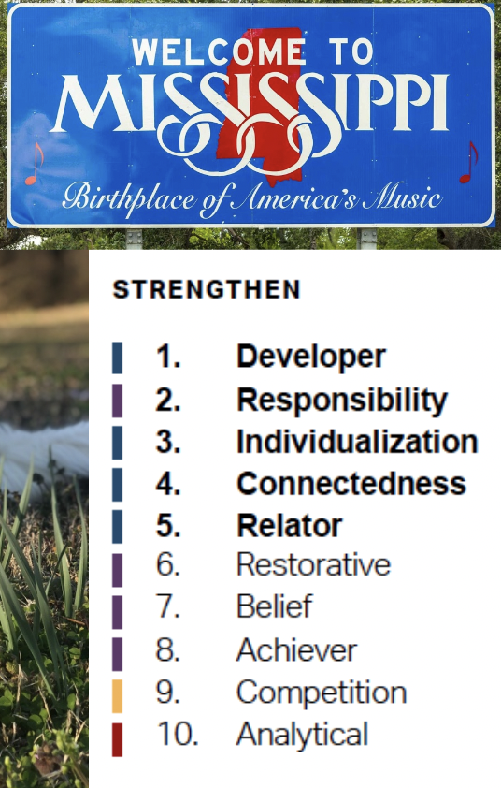



Who Am I? Professor Cowan

Slide 4

What is Computer Science?
What was the first computer?
Notes:
Ask students what they think computer science is
What do you hope to get out of this course?

Slide 5

What is Computer Science?
Computer science is the study of solving problems using computation.
Computers are part of it, but the emphasis is on the problem-solving aspect.
A computer scientist is a problem-solver.
Computer Scientists work across disciplines
Mathematics
Biology (bioinformatics)
Chemistry
Physics
Geology
Geoscience
Archeology
Psychology
Sociology
Cognitive Science
Medicine/Surgery
Engineering
Linguistics
Art
…

Slide 6
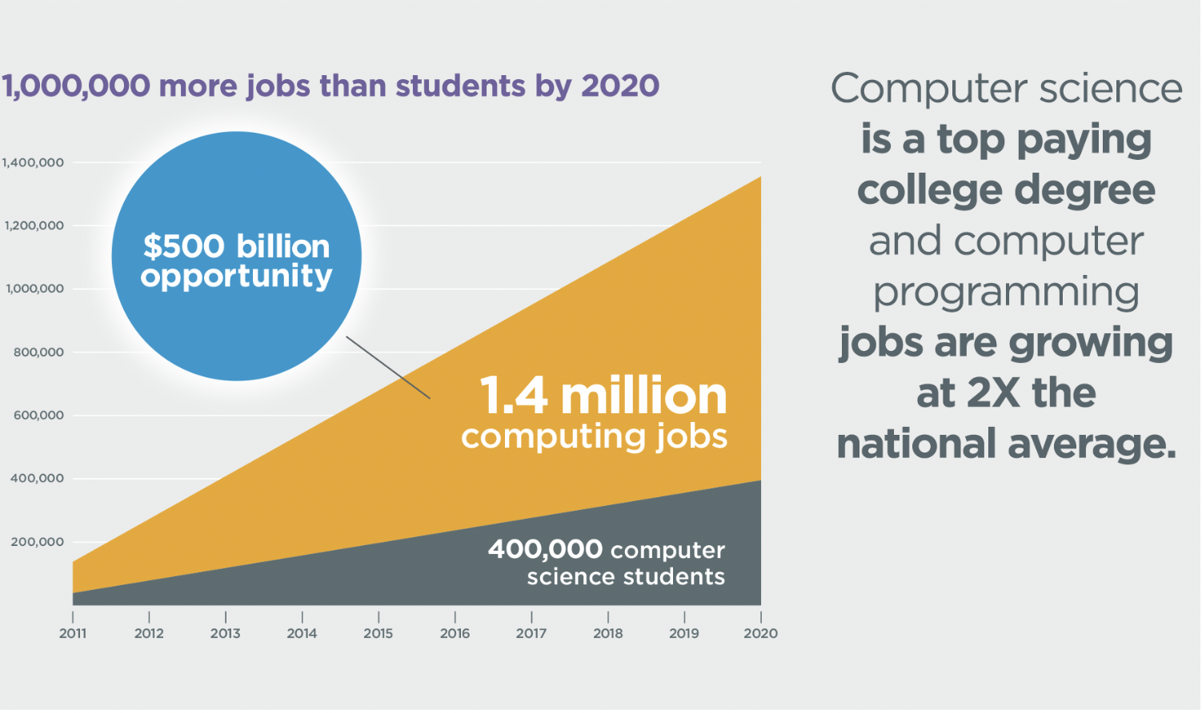
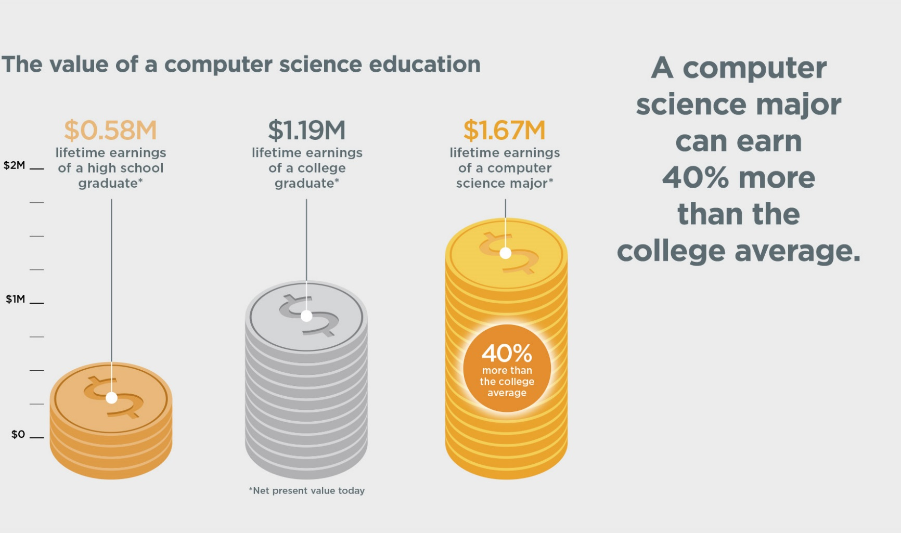
Why Study Computer Science?
Code.org
CS Careers Rank Highly In:
Job satisfaction
Salary
Work/life balance
Growth potential
Employment rate
Work environment
Notes:
Huge growth in Computing-Related Jobs!
Get a Job!
US News latest poll of top jobs contained 4 computer science jobs out of it’s top 10!
Computer Systems Analyst
Database Administrator
Software Developer
Web Developer
Many other job available!
“Nationwide there is a well-documented shortage of graduates in computer science”, writes guest columnist Edward D. Lazowska. (published May 11, 2013)
Bureau of Labor Statistics projects that 70 percent of all new jobs across all STEM fields during this decade will be in computer science.

Slide 7
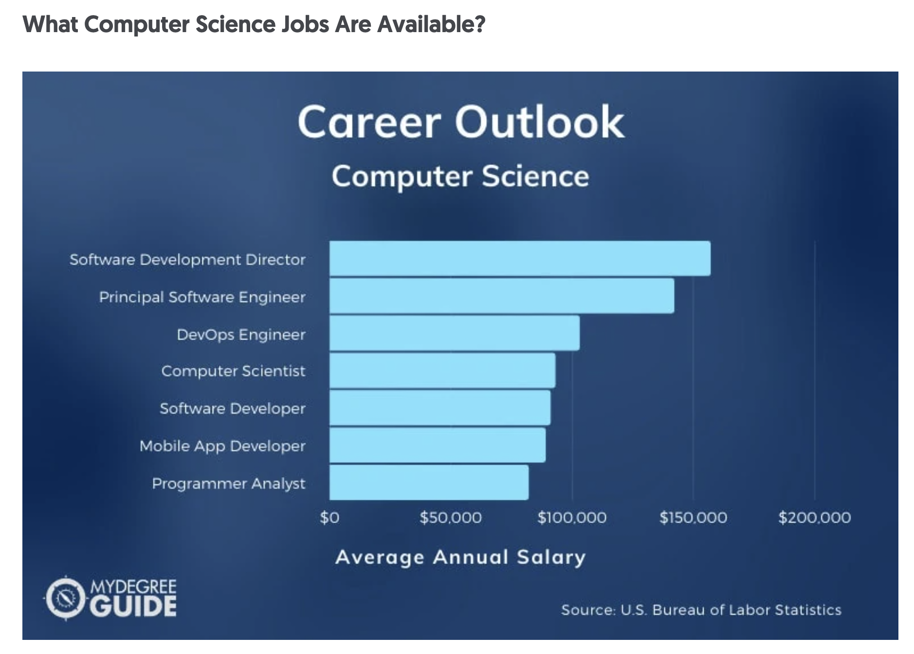

Slide 8
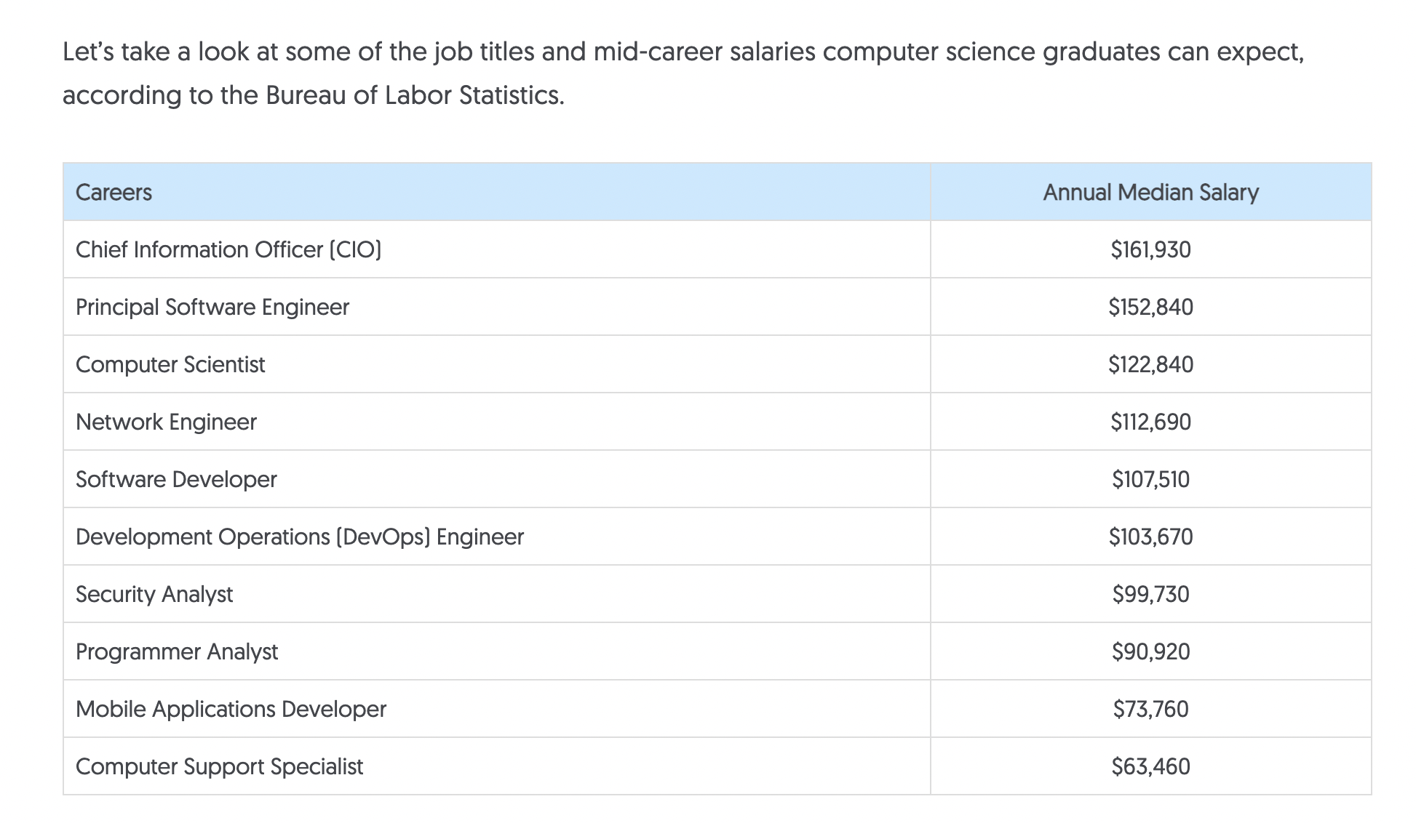

Slide 9

Why Study CS at Rhodes?
"Everyone should learn how to program a computer, because it teaches you how to think. I view computer science as a liberal art, something everyone should learn to do." -Steve Jobs
Liberal arts background is great!
Employers want to see:
Communication skills (written & verbal)
Strong work ethic
Teamwork skills (works well with others)
Initiative
Interpersonal skills (relates well to others)
Problem-solving skills
Notes:
If you think you want to major or minor in CS or you’re just interested, think about signing up for the computer science club or the women in computing club at the sacks fair in the fall.

Slide 10
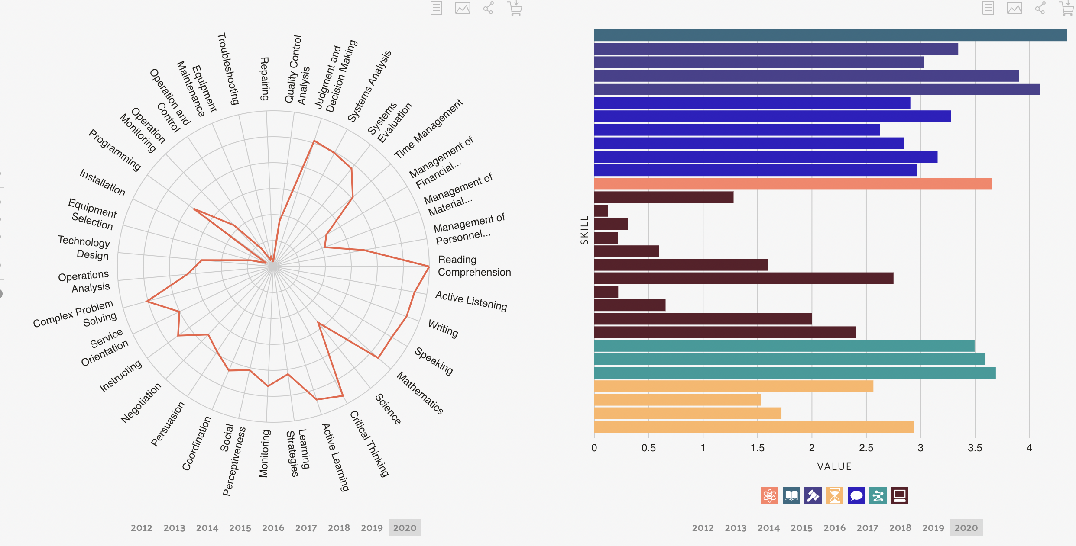
Skills Demand

Slide 11
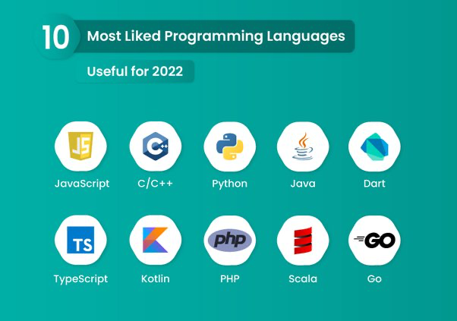
Course Logistics
Canvas
Refer to Course Schedule often!
Workload
Programming Projects – 20%
Quizzes – 5%
Zybook Assignments – 5%
Labs – 5% - graded for completion – due by 11:59pm on day they are assigned, unless otherwise noted (will be given in-class time to complete)
2 Midterm Exams -20% each
Final Exam (Cumulative) -25% (Check syllabus for date)
Notes:
Now that we’ve talked about why computer science is great to study, let’s talk a bit more about what to expect from this course.
Bring up Canvas site – show Course Schedule, talk about each graded item type
Questions??

Slide 12

Technology for this class
Laptop/Desktop/Virtual Machines in Computer Lab
Jupyter Notebooks - class notes, projects & labs
Okpy.org – submissions
Canvas – course information, syllabus
zyBooks – textbooks & assignments,
Notes:
You’ll want an actual computer, not a phone for this class. As much as you probably could take this class with only a smart phone, it would be awful to try to type Python code in with a phone
You don’t have to install any software for this course.

Slide 13

Designing a Program
Programs must be designed before they are written
Program development cycle:
Design the program
Write the code
Correct syntax errors
Test the program
Correct logic errors
Notes:
Ask for questions about any of the course stuff before moving on.

Slide 14

Designing a Program
Design is the most important part of the program development cycle
Understand the task that the program is to perform
Work with customer to get a sense what the program is supposed to do
Ask questions about program details
Create one or more software requirements

Slide 15
Designing a Program
Determine the steps that must be taken to perform the task
Break down required task into a series of steps
Create an algorithm, listing logical steps that must be taken
Algorithm: set of well-defined logical steps that must be taken to perform a task
Notes:
Algorithms are like recipes for your program.

Slide 16
Pseudocode
Pseudocode: fake code
Informal language that has no syntax rule
Not meant to be compiled or executed
Used to create model program
No need to worry about syntax errors, can focus on program’s design
Can be translated directly into actual code in any programming language
Notes:
Pseudocode example on next slide

Slide 17
Pseudocode Example
Write an algorithm for adding two numbers and outputting the sum.
Get value 1 from user, store in x
Get value 2 from user, store in y
Add x and y, store sum in z
Output z
Notes:
Pseudocode example on next slide

Slide 18
How to Ask for Help
If you feel stuck, make a strong effort to figure things out on your own—these are often the moments where you learn the most. If you are still stuck, there are several acceptable ways to get help:
You may ask Professor Cowan for help, either during office hours or email
You may go to CS tutoring, typically from 5p-11p, Sunday through Thursday, in Briggs.
You may ask a classmate (or someone not in the class) for help.
Notes:
Pseudocode example on next slide

Slide 19
How to Ask for Help
When asking for help, or when helping a classmate, you must follow the following principle:
“Understanding, not answers.”
More concretely, here are some good questions to ask others when you are stuck:
How does [insert Python feature] work in Python?
Can you listen to my reasoning about this problem and see if it makes sense?
Can you help me trace my code to understand what it is actually doing?
How should I interpret this error message?
you may not copy code from another student, from the internet, or from an artificial intelligence program.
You may not ask anyone else to tell you what code to write. Receiving or giving help in these ways will be considered an honor code violation.
Notes:
Pseudocode example on next slide

Slide 20
Things to Remember
Computers are dumb!
Computers only do what you tell them to do.
Computer do what you tell them to do really fast, so they appear smart (but they are not).
Computer don’t remember anything unless you tell them how to remember.
Computers take your instructions literally. If you tell them to do something dumb, they do it.
A computer only does what it is told and in exactly the order you tell it.

Slide 21
Your To Do List
Complete the Course Survey (be sure to include your Gmail address)
Purchase the textbook (Zybook)
Log in to the Jupyter Notebook environment to ensure you have access.
Start reading your ZyBook chapters 1&2 and working on the exercises.
Notes:
Pseudocode example on next slide

Slide 22

Questions/Thoughts/Concerns….

